Slide 1
CLASSIFICATION GROUP
PP22/0629
Scope: Others
Topic: Divorce Prediction: Uncover what makes relationships last or break
Task:
Is it possible to predict whether a marriage will fail or succeed?

Slide 2
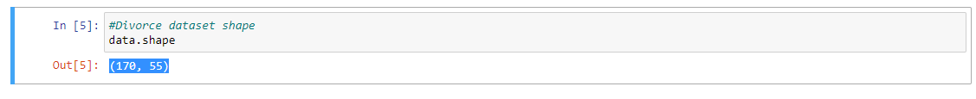
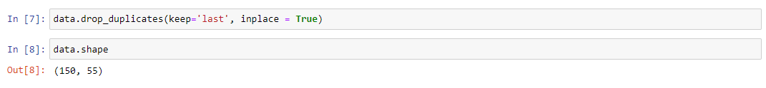
Exploratory Data Analysis(EDA)
The dataset consist of 170 indivdiual data and 55 features, target variable included.
The dataset contains no missing values.
The dataset contains 20 duplicate values that were dropped.

Slide 3
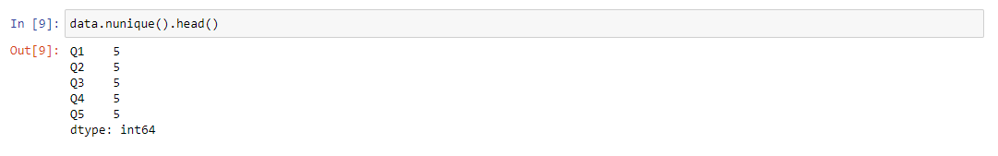
Exploratory Data Analysis
The EDA shows that all the columns in the data consist of 5 unique values. This analysis is necessary in order to identify and delete columns with 1 unique value as it will not contribute to the classification model.

Slide 4
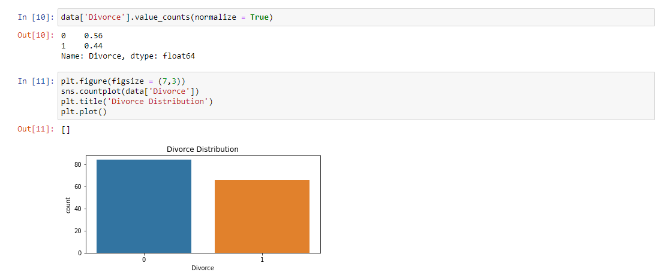
Exploratory Data Analysis
The EDA shows that 56% of the dataset are not divorced while the other 44% got a divorce.

Slide 5
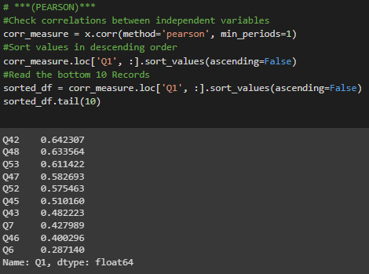
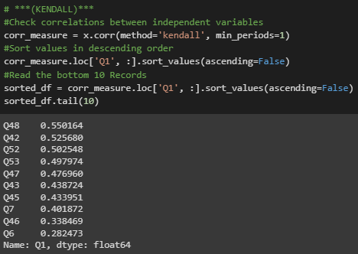
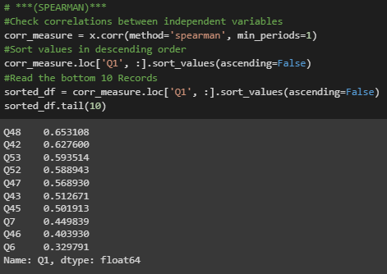
FEATURE SELECTION
3 correlation methods were used and their results on most impactful questions compared.
This was done in order to explore the predictive factors that lead to divorce

Slide 6
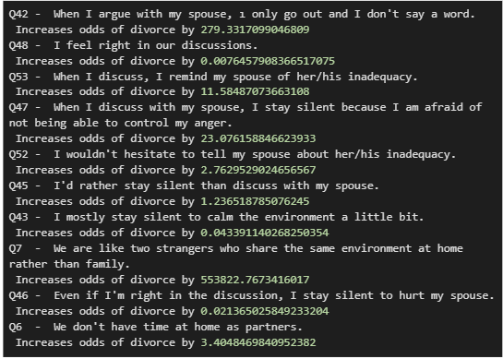
FEATURE SELECTION
Question Impact on Determining Divorce
The exponent of the variable coefficients gives the impact of these variables

Slide 7
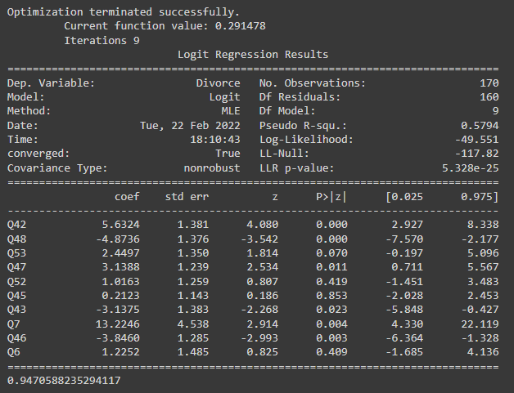
Model Building
Logistic Regression was used since this was a classification problem.
Steps taken to build the model were:
Read data into notebook
Normalize dataset to a common scale
Fit a logistic regression on the training dataset
Check model accuracy and goodness of fit

Slide 8
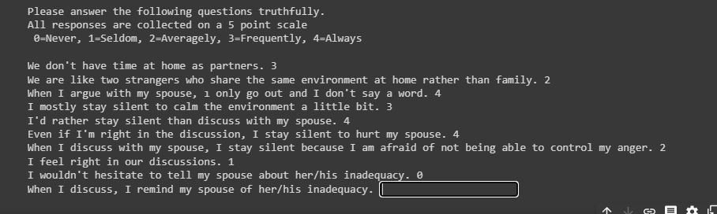

Demo/Use Case
The model can predict divorce among couples with 95% accuracy.

